Slide 1
Chapter 17
Software Testing Strategies
Slide Set to accompany
Software Engineering: A Practitioner’s Approach, 7/e
by Roger S. Pressman
Slides copyright © 1996, 2001, 2005, 2009 by Roger S. Pressman
For non-profit educational use only
May be reproduced ONLY for student use at the university level when used in conjunction with Software Engineering: A Practitioner's Approach, 7/e. Any other reproduction or use is prohibited without the express written permission of the author.
All copyright information MUST appear if these slides are posted on a website for student use.
These slides are designed to accompany Software Engineering: A Practitioner’s Approach, 7/e (McGraw-Hill, 2009) Slides copyright 2009 by Roger Pressman.

Slide 2
Software Testing
Testing is the process of exercising a program with the specific intent of finding errors prior to delivery to the end user.
These slides are designed to accompany Software Engineering: A Practitioner’s Approach, 7/e (McGraw-Hill, 2009) Slides copyright 2009 by Roger Pressman.

Slide 3
What Testing Shows
Errors
Requirements Conformance
Performance
An indication of quality
These slides are designed to accompany Software Engineering: A Practitioner’s Approach, 7/e (McGraw-Hill, 2009) Slides copyright 2009 by Roger Pressman.

Slide 4
Strategic Approach
To perform effective testing, you should conduct effective technical reviews. By doing this, many errors will be eliminated before testing commences.
Testing begins at the component level and works "outward" toward the integration of the entire computer based system.
Different testing techniques are appropriate for different software engineering approaches and at different points in time.
Testing is conducted by the developer of the software and (for large projects) an independent test group.
Testing and debugging are different activities, but debugging must be accommodated in any testing strategy.
These slides are designed to accompany Software Engineering: A Practitioner’s Approach, 7/e (McGraw-Hill, 2009) Slides copyright 2009 by Roger Pressman.

Slide 5
V & V
Verification refers to the set of tasks that ensure that software correctly implements a specific function.
Validation refers to a different set of tasks that ensure that the software that has been built is traceable to customer requirements. Boehm [Boe81] states this another way:
  Verification: "Are we building the product right?"
  Validation: "Are we building the right product?"
These slides are designed to accompany Software Engineering: A Practitioner’s Approach, 7/e (McGraw-Hill, 2009) Slides copyright 2009 by Roger Pressman.

Slide 6
Who Tests the Software?
Developer
  Understands the system but, will test "gently“ and, is driven by "delivery“
Independent tester
  Must learn about the system, but, will attempt to break it and, is driven by quality
These slides are designed to accompany Software Engineering: A Practitioner’s Approach, 7/e (McGraw-Hill, 2009) Slides copyright 2009 by Roger Pressman.

Slide 7
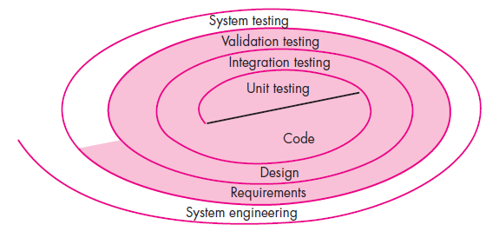
Testing Strategy
These slides are designed to accompany Software Engineering: A Practitioner’s Approach, 7/e (McGraw-Hill, 2009) Slides copyright 2009 by Roger Pressman.

Slide 8
Testing Strategy
We begin by ‘testing-in-the-small’ and move toward ‘testing-in-the-large’
For conventional software
  The module (component) is our initial focus
  Integration of modules follows
For OO software
  our focus when “testing in the small” changes from an individual module (the conventional view) to an OO class that encompasses attributes and operations and implies communication and collaboration
These slides are designed to accompany Software Engineering: A Practitioner’s Approach, 7/e (McGraw-Hill, 2009) Slides copyright 2009 by Roger Pressman.

Slide 9
Strategic Issues
Specify product requirements in a quantifiable manner long before testing commences.
State testing objectives explicitly.
Understand the users of the software and develop a profile for each user category.
Develop a testing plan that emphasizes “rapid cycle testing.”
Build “robust” software that is designed to test itself
Use effective technical reviews as a filter prior to testing
Conduct technical reviews to assess the test strategy and test cases themselves.
Develop a continuous improvement approach for the testing process.
These slides are designed to accompany Software Engineering: A Practitioner’s Approach, 7/e (McGraw-Hill, 2009) Slides copyright 2009 by Roger Pressman.

Slide 10
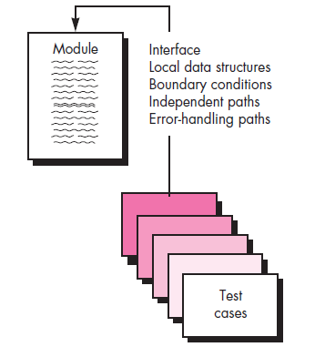
Unit Testing
These slides are designed to accompany Software Engineering: A Practitioner’s Approach, 7/e (McGraw-Hill, 2009) Slides copyright 2009 by Roger Pressman.

Slide 11
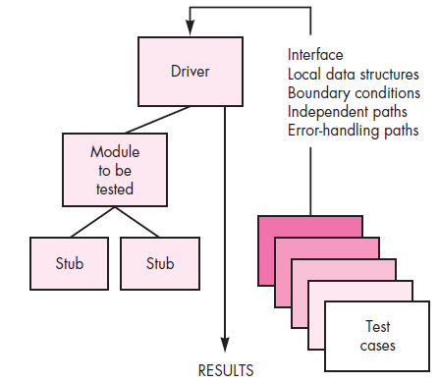
Unit Test Environment
These slides are designed to accompany Software Engineering: A Practitioner’s Approach, 7/e (McGraw-Hill, 2009) Slides copyright 2009 by Roger Pressman.

Slide 12
Integration Testing Strategies
Options:
  the “big bang” approach
  an incremental construction strategy
These slides are designed to accompany Software Engineering: A Practitioner’s Approach, 7/e (McGraw-Hill, 2009) Slides copyright 2009 by Roger Pressman.

Slide 13
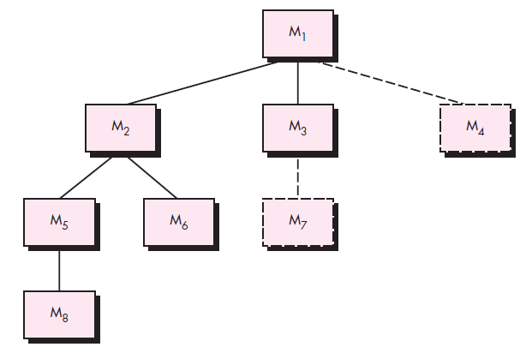
Top Down Integration
top module is tested with stubs
stubs are replaced one at
a time, "depth first"
as new modules are integrated,
some subset of tests is re-run
These slides are designed to accompany Software Engineering: A Practitioner’s Approach, 7/e (McGraw-Hill, 2009) Slides copyright 2009 by Roger Pressman.

Slide 14
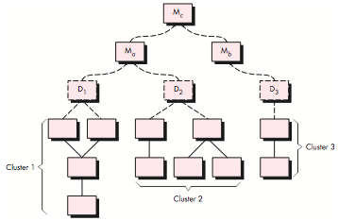
Bottom-Up Integration
These slides are designed to accompany Software Engineering: A Practitioner’s Approach, 7/e (McGraw-Hill, 2009) Slides copyright 2009 by Roger Pressman.

Slide 15
Regression Testing
Regression testing is the re-execution of some subset of tests that have already been conducted to ensure that changes have not propagated unintended side effects
Whenever software is corrected, some aspect of the software configuration (the program, its documentation, or the data that support it) is changed.
Regression testing helps to ensure that changes (due to testing or for other reasons) do not introduce unintended behavior or additional errors.
Regression testing may be conducted manually, by re- executing a subset of all test cases or using automated capture/playback tools.
These slides are designed to accompany Software Engineering: A Practitioner’s Approach, 7/e (McGraw-Hill, 2009) Slides copyright 2009 by Roger Pressman.

Slide 16
Smoke Testing
A common approach for creating “daily builds” for product software
Smoke testing steps:
Software components that have been translated into code are integrated into a “build.”
  A build includes all data files, libraries, reusable modules, and engineered components that are required to implement one or more product functions.
A series of tests is designed to expose errors that will keep the build from properly performing its function.
  The intent should be to uncover “show stopper” errors that have the highest likelihood of throwing the software project behind schedule.
The build is integrated with other builds and the entire product (in its current form) is smoke tested daily.
  The integration approach may be top down or bottom up.
These slides are designed to accompany Software Engineering: A Practitioner’s Approach, 7/e (McGraw-Hill, 2009) Slides copyright 2009 by Roger Pressman.

Slide 17
Object-Oriented Testing
begins by evaluating the correctness and consistency of the analysis and design models
testing strategy changes
  the concept of the ‘unit’ broadens due to encapsulation
  integration focuses on classes and their execution across a ‘thread’ or in the context of a usage scenario\
  validation uses conventional black box methods
test case design draws on conventional methods, but also encompasses special features
These slides are designed to accompany Software Engineering: A Practitioner’s Approach, 7/e (McGraw-Hill, 2009) Slides copyright 2009 by Roger Pressman.

Slide 18
Broadening the View of “Testing”
It can be argued that the review of OO analysis and design models is especially useful because the same semantic constructs (e.g., classes, attributes, operations, messages) appear at the analysis, design, and code level. Therefore, a problem in the definition of class attributes that is uncovered during analysis will circumvent side effects that might occur if the problem were not discovered until design or code (or even the next iteration of analysis).
These slides are designed to accompany Software Engineering: A Practitioner’s Approach, 7/e (McGraw-Hill, 2009) Slides copyright 2009 by Roger Pressman.

Slide 19
OO Testing Strategy
class testing is the equivalent of unit testing
  operations within the class are tested
  the state behavior of the class is examined
integration applied three different strategies
  thread-based testing—integrates the set of classes required to respond to one input or event
  use-based testing—integrates the set of classes required to respond to one use case
  cluster testing—integrates the set of classes required to demonstrate one collaboration
These slides are designed to accompany Software Engineering: A Practitioner’s Approach, 7/e (McGraw-Hill, 2009) Slides copyright 2009 by Roger Pressman.

Slide 20
WebApp Testing - I
The content model for the WebApp is reviewed to uncover errors.
The interface model is reviewed to ensure that all use cases can be accommodated.
The design model for the WebApp is reviewed to uncover navigation errors.
The user interface is tested to uncover errors in presentation and/or navigation mechanics.
Each functional component is unit tested.
These slides are designed to accompany Software Engineering: A Practitioner’s Approach, 7/e (McGraw-Hill, 2009) Slides copyright 2009 by Roger Pressman.

Slide 21
WebApp Testing - II
Navigation throughout the architecture is tested.
The WebApp is implemented in a variety of different environmental configurations and is tested for compatibility with each configuration.
Security tests are conducted in an attempt to exploit vulnerabilities in the WebApp or within its environment.
Performance tests are conducted.
The WebApp is tested by a controlled and monitored population of end-users. The results of their interaction with the system are evaluated for content and navigation errors, usability concerns, compatibility concerns, and WebApp reliability and performance.
These slides are designed to accompany Software Engineering: A Practitioner’s Approach, 7/e (McGraw-Hill, 2009) Slides copyright 2009 by Roger Pressman.

Slide 22
High Order Testing
Validation testing
  Focus is on software requirements
System testing
  Focus is on system integration
Alpha/Beta testing
  Focus is on customer usage
Recovery testing
  forces the software to fail in a variety of ways and verifies that recovery is properly performed
Security testing
  verifies that protection mechanisms built into a system will, in fact, protect it from improper penetration
Stress testing
  executes a system in a manner that demands resources in abnormal quantity, frequency, or volume
Performance Testing
  test the run-time performance of software within the context of an integrated system
These slides are designed to accompany Software Engineering: A Practitioner’s Approach, 7/e (McGraw-Hill, 2009) Slides copyright 2009 by Roger Pressman.

Slide 23
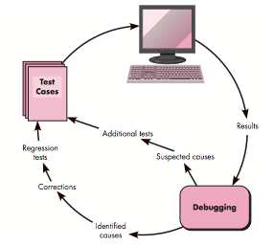
Debugging
These slides are designed to accompany Software Engineering: A Practitioner’s Approach, 7/e (McGraw-Hill, 2009) Slides copyright 2009 by Roger Pressman.

Slide 24
Symptoms & Causes
In many cases, the noncorresponding data are a symptom of an underlying cause as yet hidden. The debugging process attempts to match symptom with cause, thereby leading to error correction.
symptom and cause may be geographically separated
symptom may disappear when another problem is fixed
cause may be due to a combination of non-errors
cause may be due to a system or compiler error
cause may be due to assumptions that everyone believes
symptom may be intermittent
These slides are designed to accompany Software Engineering: A Practitioner’s Approach, 7/e (McGraw-Hill, 2009) Slides copyright 2009 by Roger Pressman.

Slide 25
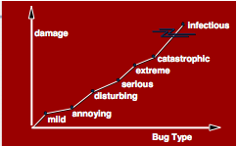
Consequences of Bugs
These slides are designed to accompany Software Engineering: A Practitioner’s Approach, 7/e (McGraw-Hill, 2009) Slides copyright 2009 by Roger Pressman.

Slide 26
Debugging Techniques
brute force / testing
  Most common; but least efficient
  memory dumps are taken, run-time traces are invoked, and the program is loaded with output statements
Backtracking
  common debugging approach that can be used successfully in small programs.
  source code is traced backward (manually) until the cause is found
Cause elimination
  A “cause hypothesis” is devised
  If initial tests indicate that a particular cause hypothesis shows promise, data are refined in an attempt to isolate the bug
These slides are designed to accompany Software Engineering: A Practitioner’s Approach, 7/e (McGraw-Hill, 2009) Slides copyright 2009 by Roger Pressman.

